Slide 1

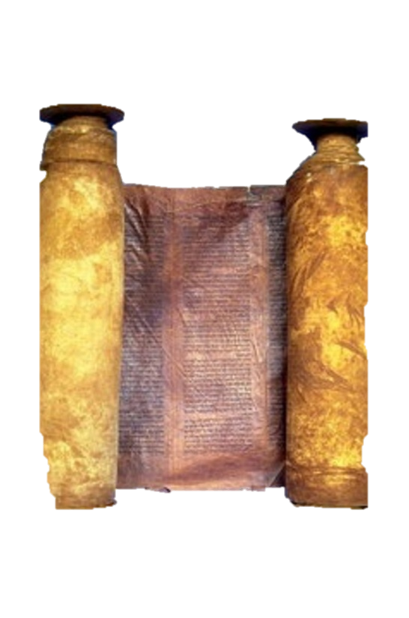




A free CD of this message will be available immediately following the service
1 Kings
11.14-13.34
A podcast will also be available later this week at calvaryokc.com

Slide 2



2 Pet. 1:19 ~ And so we have the prophetic word confirmed,
Phillips ~ Thus we hold the word of prophecy to be more certain than ever.
Wuest ~ And we have the prophetic word as a surer foundation…
1 kings 11.14-13.32

Slide 3
1 kings 11.14-13.32

Slide 4
Adversary ~ satan
1 kings 11.14-13.32

Slide 5
1 kings 11.14-13.32

Slide 6
Power leads to pride
Pride leads to arrogance
Arrogance leads to forgetfulness of God
Forgetfulness leads to apostasy
1 kings 11.14-13.32

Slide 7
1 kings 11.14-13.32

Slide 8
Eccl. 2.18-19 ~ ¹⁸ Then I hated all my labor in which I had toiled under the sun, because I must leave it to the man who will come after me. ¹⁹ And who knows whether he will be wise or a fool? Yet he will rule over all my labor in which I toiled and in which I have shown myself wise under the sun. This also is vanity.
1 kings 11.14-13.32

Slide 9
1 kings 11.14-13.32

Slide 10
“All who will may enter.”
“Chosen before the foundations
of the world”
“All who will may enter.”
1 kings 11.14-13.32

Slide 11
1 kings 11.14-13.32

Slide 12
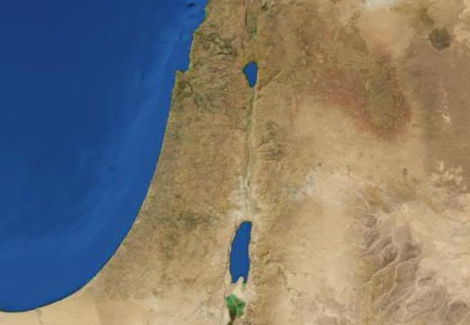
Divided Kindom
Israel
Jerusalem
Philistia
Judah
1 kings 11.14-13.32

Slide 13
1 kings 11.14-13.32

Slide 14
Israel
Judah
Jeroboam, 931-910
1 kings 11.14-13.32

Slide 15
1 kings 11.14-13.32

Slide 16
1 Kings 11.38 ~ Then it shall be, if you heed all that I command you, walk in My ways, and do what is right in My sight, to keep My statutes and My commandments, as My servant David did, then I will be with you and build for you an enduring house, as I built for David, and will give Israel to you.
1 kings 11.14-13.32

Slide 17
1 kings 11.14-13.32

Slide 18
Josiah ~ almost 300 years later
1 kings 11.14-13.32

Slide 19
1 kings 11.14-13.32

